Slide 1
HIS: Hosting Infrastructure Services IAM 4 Virtualization Moon focus see https://plazza.orange.com/docs/DOC-660649 and
IAM4Virtualization
Multi-DC / multi-POP urbanism
Installation tooling
operational model
Cloud Service layer
Common infra services
Operation tools
Openstack
RedHat
Network controller
containerization
Ceph Storage
Compute + Storage HW
Network Hw & Engineering
David Alles, OLN/ODIS,
Ruan He and Thomas Duval, OLS/Arsec
29th January 2018
Internal Draft documentation,
Do not transfer

Slide 2
IAM4Virtualization Focus on OpenStack and its ‘Keystone’ IAM module

Slide 3
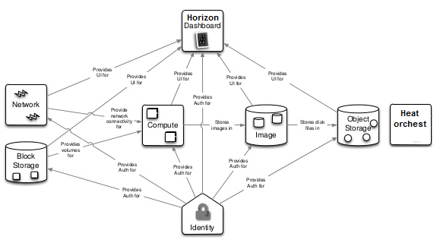
One OpenStack deployment via RH Director is one OPST/Region
VIM deployment inside one Datacenter == NGPoP
Orange
modules
extends
Contrail
Provides authentication &
Authorization for OpenStack,
Contrail
& other Orange features
Lifecycle via RH OSP Director
Grey color: This is the perimeter of the standard OPST/Keystone training ☺

Slide 4
OpenStack deployment via RH Director allocate one OPST/Domain
VIM deployment is one OPST/Region
OPST Domain
covers
OPST Projects
OPST Users
Roles == Assignments
Provides authentication &
Authorization for OpenStack,
Role == ‘admin’
Role == ‘member’
‘admin’ Project for system scoping
‘customer XX’ Project for project scoping
/!\ Issue1: sub-roles for segmentation of duties
See proposed segmentation
for sub-roles

Slide 5
Keystone is a local database: issues when IAM & ACM for the IaaS
Internal source
for Authentication
How to behave when multi-DCs
NGPoP #1
Keystone
InfraAsCode
NGPoP #1
sub roles
Keystone
Moon* as external PDP
CSS
centralized management
AD
Keystone
Internal source
for Authorizations
Too few roles
for Authorizations
sub roles
NGPoP #x
sub roles
Short-term:
Each Keystone inside one NGPoP is able to externalize its authentication source (unscoped token) on one LDAPS backend
Each Keystone inside one NGPoP is the local Authorizations database; The CSS will be the Centralized authorization referential, responsible for the management of all those NGPoP local databases via Keystone APIs.
The CSS will be responsible for the roles management (with import/ export and audit Business & Applicative roles) and for the Assignment management (import, export and audit of both CloudAdmin & Customers authorizations).
Long-term with Moon*: Starting from OpenStack version 13, Keystone will become able to delegate its authorizations via one ‘external Policy Decision Point plugin’ to connect to a ‘centralized IAM& ACM’ backend which will propose Dynamic policies management.

Slide 6
IAM4Virtualization Moon context

Slide 7
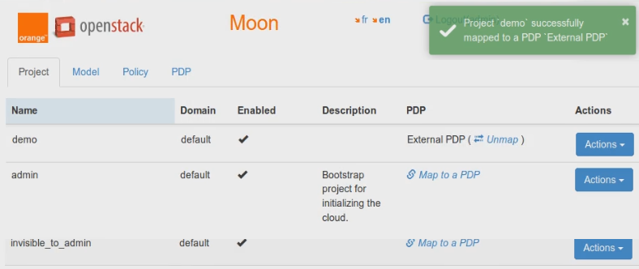
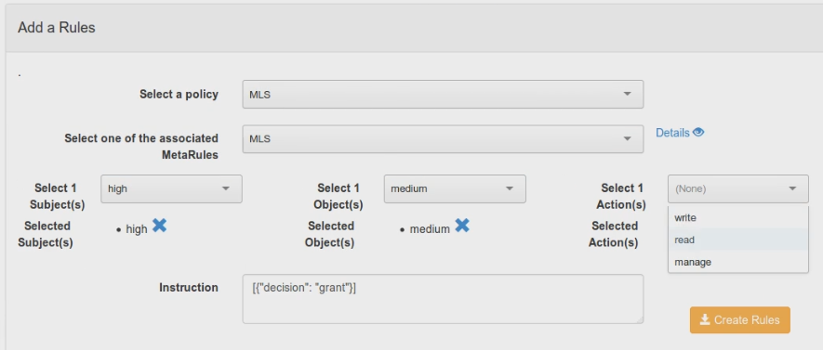
Moon logical datamodel
OPST Domain
covers
Model
Instantiate s Authz model
Policy
Supports
a policy
PDP
Provide
security features to
OPST Projects
OPST Users
Roles == Assignments
Meta rule
Define the meta rules
Subject
category
Role == ‘admin’
Role == ‘member’
‘admin’ Project for system scoping
‘customer XX’ Project for project scoping
Object
category
Action
category

Slide 8
Moon RBAC on its datamodel
OPST Domain
covers
Model
Instantiate s Authz model
Policy
Supports
a policy
PDP
Provide
security features to
OPST Projects
OPST Users
Roles == Assignments
Meta rule
Define the meta rules
Subject
category
Role == ‘admin’
Role == ‘member’
‘admin’ Project for system scoping
‘customer XX’ Project for project scoping
Object
category
Action
category
For the Cloud itself
As security enterprise expert
As security architect
For the project itself
Optional dynamic scope

Slide 9
Moon RBAC on its datamodel
Region #1 as OpenStack deployment
‘admin’ Project for system scoping
‘customer XX bis’ Project for project scoping
Centralized AuthZ management
OPST Projects
Provide
security features to
➔single policy at “system scoping” on all the Regions
Model
Policy
PDP
➔one single policy at “project scoping” for the tenants deployed onto the various Regions, per customer’s context
Define the meta rules
Meta rule
OPST Projects
Role == ‘admin’
Role == ‘member’
‘admin’ Project for system scoping
‘customer XX’ Project for project scoping
Region #n as OpenStack deployment

