Slide 1
OpenStack ‘LCOO’ user group
IAM compliancy in clustered OpenStack-based Clouds
LCOO
November 30th 2017
David Alles, Marc Bailly, Ruan He

Slide 2
What is the Orange I@M referential?
Identity and Access Management of the Orange services shall comply to the rules in effect in the Orange Group (Group I@M policy and processes, Group I@M architecture and framework) as defined by DSEC’s Group I@M Program.
At all times, the Orange Affiliate or entity responsible for service revenue must be accountable and in control of the accesses to its systems. In particular, the management of identities, the authorizations, the monitoring of security conditions in the activities of its managed services providers, MUST be under the Orange Affiliate business ownership.
The Group Identity Referential (GIR) is the reference of identities of both all internal and external staff in the Group. In the context of the virtualization operating model, it applies in particular:
for the staff working in the IaaS backend and the Human-Machine Interfaces
for the staff working for Projects using OpenStack IaaS, as such being internal customers of the IaaS organized in Project Tenants
The reference of authentication of these individuals is the Affiliate Active Directory (or equivalent) where CUID (Common User ID) identifier is the primary handle for the Identity. It is integrated to the existing Identity management in the Affiliate, i.e. the ecosystem of TIGER, the Group provisioning system for identities and other related data.
In the context of OpenStack–based transformation, a task force was setup in Q2-2017 and affiliated to Group I@M Program to identify the design principles to enable a compliant I@M chain :
a unique authentication reference
2-factor authentication for staff (group PKI-based for internal staff, OTP for external staff)
a unique reference of authorization, bare metal of IaaS, centralized authorization management (Segregation of Duties, management of business roles and application roles, check of compliance between authorizations in production and the central reference, reviews, traceability and proactive security monitoring, a centralized and monitored access control with session broker)

Slide 3
Various OpenStack Clouds are currently used:
Orange projects are deployed :
On internal Clouds: we master the design, then we can adjust the I@M compliancy
Lodz-Openwatt as the first Regional Cloud for IS & SDP: running in production since 2015, being complemented in Psary with a second site.
IaaS4Telco in OSP, OSK… : deployment will start in 2018 for emerging NFV.
Cloud
Watt
Flexible Engine
France, Europe by OBS/OCB
Customer
On existing ‘public clouds’ from OBS/OCB portfolio: In a first step we can adjust our behaving as customers. In a second step we can partner with OCB to enhance the integration services to Identity federation.
Different workloads…
➔none of them is yet compliant to Orange I@M requirements: see next slide.
Service Platform
IS
Network
Actors on each Cloud are:
The CloudAdmins, operating the Cloud Infrastructure and the various [Managed] services
The Customers, ordering Cloud services (compute, storage, network resources) and deploying their workloads in the Cloud.
Actors can be human or technical orchestrators
As CloudAdmin: the automated OPS tasks that care of the Cloud.
As customer: VNF Manager for Telco workloads are using the Cloud’s APIs to control the VNF(s) (deployment/ upgrade/ scale Up&Down/ resiliency )
Actors can even be micro-services from a Cloud Native Application
New applications (or renovated applications) are composed of micro/macro services
Some micro-services may request the use of Cloud’s APIs to control the application behavior (few among tens per application deployed as CNA in the Cloud)
Different implementation topologies for Orange countries…
Orange Services
IT
Orange Services
IT/SPF
Orange Services
VNF
SPF
VNF
IT/SPF?
[some] REGIONAL DataCenters == Lodz-Openwatt
[0-2xsome]
NATIONAL
DataCenters
[some dozens]
LOCAL
NG-PoPs
Europe, MEA multi-country
countries

Slide 4
Orange I@M compliancy: Details on OpenStack multi-sites issues
When considering the Telco architecture in multi OpenStack-based NGPoPs== DCs:
Source for Authentication cannot be local to each site. Central management of the authentication process is required and will the support to the strong authentication: Affiliate Active Directory must be the backend for LDAP protocol.
Official CUID must be used for Staff and technical identities.
How to support multi-NGPoPs inside one Cloud?
Internal DB
for Authentication
Possible roles for actors are defined locally per sites. This must become centralized and ‘static policy files’ usage must be deprecated asap and be replaced by a dynamic solution (➔external PDP).
Too few roles are predefined inside the OpenStack architecture to allow segmentation of duty. Currently no distinct scoping between “System” and “Tenant”. Roles mapping between OpenStack and external SDN is not trivial. ➔New roles must be built and deployed from a central management platform.
NGPoP #1
Keystone
A central IAM&ACM process must manage:
Centralized database for assignments (see Moon as External PDP, see below): ➔Short term with Newton based cloud will be an external synchronization of the local Keystone assignment via one IAM&ACM mediation platform (CSS, see below)
Assignment of role(s) at “System” scope on all the sites must be executed per CloudAdmin user on per-individual principle: for a single identifier and its seamless representation inside the Keystone/user DB (“ghost user”) on all sites.
Assignment of role(s) at “tenant’ scope on few or all sites must be executed per CloudAdmin or Customer user: for a single identifier on all sites.
/!\ Current issue on the local accounts with password in plain text for core services and ‘admin’ users. Those accounts are not synchronized by default. Periodical change of those passwords is a pain.
Internal DB
for Authorizations
Too few roles
for Authorizations
sub roles
Tenant management on all sites (“tenant across sites”) can no longer be simply executed (the same Project_ID on all the OPST sites)➔external mapping table is required for tenant across sites and related authorizations ☹ ➔Source code for ‘OPST/Project ID allocation when creating the tenant to be backported
➔Global target: Moving from single static policy to multiple dynamic security policies!

Slide 5
Proposed I@M compliancy path

Slide 6
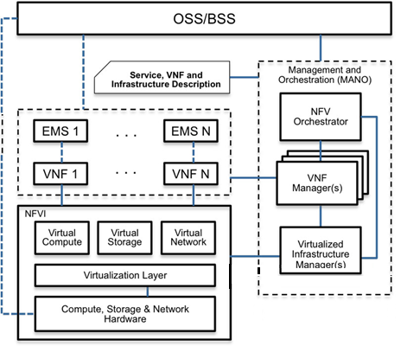
Mapping on ETSI NFV model: CSS (‘BSS of the Cloud’) to provide CSP features
Under the responsibility of the Network Operator (NOP)
Customer: formalize SLA
Hosting Infra & Services
Under the responsibility of Cloud Service Provider (CSP): Cloud Services catalog, customer onboarding … Support for IAM & ACM
Under the responsibility of the Virtualized Infrastructure services Provider (VISP)
Cloud Service Support
formalize SLA
Under the responsibility of the Physical Infrastructure services Provider (PISP)
formalize SLA
Under the responsibility of the Data Center Services Provider (DCSP)
Data Center

Slide 7
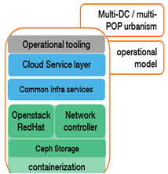
Complying to Orange I@M requirements for the IaaS: The CSS to manage the IAM & ACM processes
Hosting Infra Services
GIR
I@M Tiger
provisioning
Affiliate AD or
‘multi-country’ AD
To cover IAM & ACM
on Multi-sites context
Operation tools
Common
AD
For Regional cloud (see Lodz-OPW)
and IaaS4Telco Cloud (OSP, OSK, …)
Authentication
CUID for Human & tech identities
Authorizations mngt
Authorizations enforcements: short term
sub roles static Oslo policy files
Authorizations enforc^{t}: long term: dynamic policies via Moon
Audit & Compliancy mngt
Accounting

Slide 8
Enlarging the IAM&ACM coverage for both IaaS and workloads
NGPoP #1
Keystone
VNF &VNFM
Tenant
External IAM & ACM
referential
sub roles
CSS
centralized management
API use
AD
Moon* as external PDP
Keystone
On physical elements
Access control
& traceability
sub roles
NGPoP #x
Ops tools
Short-term: Each Keystone inside one NGPoP is the local Authorizations database; The CSS will be the Centralized authorization referential, responsible for the management of all those NGPoP local databases via Keystone APIs.
Short-term: The CSS will be responsible for the roles management (with import/ export and audit Business & Applicative roles) and for the Assignment management (import, export and audit of both CloudAdmin & Customers authorizations).
Long-term with Moon*: Starting from OpenStack version 13, Keystone will become able to delegate its authorizations via one ‘external Policy Decision Point plugin’ to connect to a ‘centralized IAM& ACM’ backend which will propose Dynamic policies management. Orange innovation is ‘Moon’, already integrated in OPNFV community and designed and delivered as an Open Source project

Slide 9
Moon: How it works?
Security
Policy
Security
Policy
Security
Policy
Security
Policy
Security
Policy
Policy Engine
Tenant Manager
Tenant Manager
Infra Manager
OpenStack2 Manager
ODL Manager
Moon
protect the
infrastructure
protect
another
OpenStack
protect
OpenDaylight
protect a tenant
protect a tenant
vm
vm
vm
vm
Tenant
Tenant
OpenStack1
OpenStack2
OpenDaylight

Slide 10
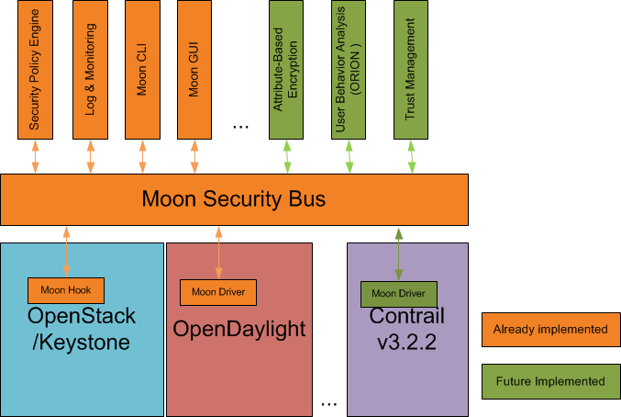
Moon: Security Management Framework
An innovative and proven solution to outsource security functions
Paving the way for business opportunities through open source
Based on Policy Enforcement Point (hook/ driver)

Slide 11
Moon Collaboration with open source communities
OpenStack
SDN Controller
OpenDaylight
ONAP
IAM
Data Encryption
Monitoring
SecWatt
?upsteam
upsteam
upsteam
Identity Federation
User Behavior Anlyze
…
Moon: security bus
Pluggable Security Management:
Extend application areas (ONAP, OSS, BSS)
Accelerate the integration of new security functions
Support new value-added services (billing, user behavior analysis, etc)

Slide 12
Backup slides

Slide 13
FEATURES
Key features of CSS
Cloud Orchestration service to augment Customer user Experience and Cloud Administration capabilities. The CSS product is developed as Horizon UI extensions + Python Backend, is delivered in CI/CD mode as containers
 | Full CSS: target is Regional Cloud | ‘Light ‘ CSS: target is IaaS4Telco
IAM and ACM
Compliance to Orange I@M Identity Access Management | By ~S2-2018, compliant to CUID and Active Directory usage for Human and technical orchestration | Idem, requested for OSP/Madrid in April 2018 !
Management of Applicative and Business roles for customers and Cloud Admin | By Q4-2017, Dynamic composition of roles to be allocated to Cloud Admin and customers | Idem (will add Contrail support by Q1-2018) requested for OSP/Madrid in April
Compliancy to Orange Audit Compliance Management | Audit of the roles and assignments on all the sites of the Cloud by Q4-2017 | Idem, requested for OSP/Madrid in April
Cloud Service Support product delivers the managed services
Usage | Regional Cloud | National Cloud | NG POP ‘IaaS4Telco’
Features eligibility | CSS with full self service | To be defined. OPL national cloud is the only ‘National Cloud’ | ‘light’ CSS for IAM & ACM
Project target | Psary DC, Q1-18 Lodz+Psary, Q2 | No target currently identified | OSP in Q1-18 OSK in Q2
Customer facing features: [Self-] CSP services
Customer Onboarding | Self service, similar to public Cloud | By Cloud Administrators
Users and Roles management | Self service, similar to public Cloud | Not applicable
Trial mode | Free usage of limited quotas for1 month | Not applicable
Predefined tenants patterns | Full Internet, Non prod, Prod | Not applicable
Tenant external connectivity | Self service to access to external Networks (eg. Internet, GIN EFA, GIN IS) | Not applicable
Quotas self management | Self service, for increase, & decrease | Idem, to be agreed
Welcome office & Customer care | Access to Knowledge and feedback bases, ticketing tool | Not applicable
Standard Horizon features | Dedicated User Interface, as an extension from the standard RedHat Horizon | Idem
Common Infra services access | Exposure of common Infra services, with 1-click catalog
Cloud administrators features
Metering / Billing / Invoicing | Used by OBS/OCB; will be used by OPL Opex mode in “Pay as U go” | Applicable ? Because IaaS4Telco workloads are running in ~Capex mode
CSS compatibility matrix | Mitaka, OSP 10 Newton | OSP 10 + Contrail 3.2(ongoing)

Slide 14
CSS: Current management of the IAM & ACM for the IaaS (SP#67)
NGPoP #1
VNF &VNFM
Keystone
Tenant
External IAM & ACM
referential
sub roles
From OSP Director,
With VIM G3R1.1
CSS
centralized management
API use
/!\ Expose Keystone admin & internal endpoints from all sites to enable central IAM & ACM
OSP Director to deploy
Orange Policy.json files
CloudAdmin actor to use CSS to import Business2App roles
CloudAdmin actor to use CSS to assign Bus roles to one CloudAdmin
CloudAdmin & Customer actors to use CSS to assign Bus roles to one Customer
sub roles
Policy.json from OPST ➔permissions on API
Sub roles
assignments
assignments
CloudAdmin actor to use CSS to export Business2App roles from any site
CloudAdmin actor to use CSS to export all roles assigned to all CloudAdmins
CloudAdmin actor to use CSS to export all roles assigned on one Customer account & projects
CloudAdmin actor to use CSS to audit Business2App roles on all sites, from reference JSON
CloudAdmin actor to use CSS to audit CloudAdmin assignments on all sites from reference JSON
CloudAdmin actor to use CSS to audit Customer assignments on all sites from reference JSON
[External] Audits

Slide 15
Orange I@M compliancy: Details on OpenStack multi-sites [re]configurations
/!\ incorrect naming of ‘Region’ inside the OPST modules’ config files
Data plane
Control plane
Service plane
Under Cloud node
CSS in
light mode
2bis
5
external networks
overlay
PDP in Keystone
in multi-Regions
public [& Admin] APIs
DC Gateway
Keystone
OPST [& Contrail]
OPST [&Contrail]
CSS in HA mode
OPST [& Contrail]
internal
APIs
IAM
secrets mngt
OPST [&Contrail]
6
1
Multi sites
7
centralized
FCAPS
tools
2
Images mngt
Tenant across
Identity Provider
==Active Directory Backend
4
Flavors mngt
/!\ forcing the
‘tenant OPST ID
8
3
OPST [&Contrail]
DC Gateway
OPST [& Contrail]
sub roles
OPST [&Contrail]
OPST [& Contrail]
Under Cloud node
Temporary target is VIM/G3R1.1 or R2: (before OSP13 & Moon): January 2018
4
Status: no short term possibility to implement this with OSP10 ‘Newton’ and Keystone local authentications : (Keystone DB is impossible in Production; forcing the OPST ID of the tenant is no longer possible: to be changed!! ➔ centralization to be implemented via CSS
Target is VIM/G4Rx: 2018

Slide 16
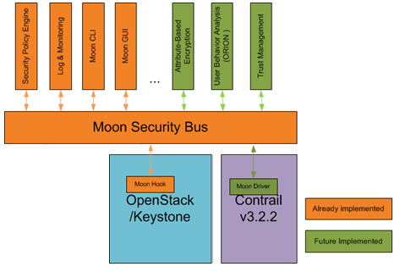
Long term target: Moon as external PDP implementation, in order to cover the Orange products (incl. OPST, Contrail and the CSS…)
First Moon policies are RBAC, MLS & DTE…
CSS
ODL
for OPNFV
OPS
(Velum)
/!\ no-one is capable to
implement
this driver
with Juniper

